Slide 1
Live session 5 Repeated Measures
Experimental Statistics II

Slide 2
Conceptual Question #1
Is it required that each predictor needs to be normally distributed in a regression model?

Slide 3
Conceptual Question #1
Is it required that each predictor needs to be normally distributed in a regression model?
ANSWER: NO
Recall that if this was true, then we would never be able to include dummy variables or categorical variables since they are clearly not normally distributed. The requirement is solely in the errors.

Slide 4
Conceptual Question #1
Simple example

Slide 5
Conceptual Question #2
Residuals are still normally distributed so there is nothing wrong.

Slide 6
Which of the following qq-plots indicates that the data is not normally distributed?

Slide 7
Which of the following qq-plots indicates that the data is not normally distributed?

Slide 8
ANSWER
They all are coming from the normal distribution!
THE POINT
With smaller sample sizes, normality can be really hard to assess from data set to data set. As you just saw. It is also true the other way around (data is actually not normal but the qqplot supports normality)
With larger data sets, regression coefficients have Central Limit Theorem type properties, so the t-test is still valid regardless if the residuals are normal or not. (This is true for normality only, large sample size does not get us around nonconstant variance issues.)

Slide 9
A High Level View
Key assumptions:
Normality of residuals
Constant variance

Slide 10
Multivariate Intro
Multivariate Analysis, in general, typically involves the analysis of multiple response variables.
This is slightly different from regression where it is assumed that there is only one response variable and all remaining variables are fixed values.
Repeated measures is not technically (in my view) a Multivariate Technique. Why? There is only one response variable.
It is important to parse these two methods out. There are multivariate frame work and techniques under the hood in a repeated measures analysis but its more of a means to an end.
In reality, the overall F-test tables you have seen in previous units along with proc autoreg, all use multivariate framework to deal with correlation in different ways.
Yes, even when observations are independent with each other, correlation creeps into the problem in different ways. Regression coefficients are correlated with each other

Slide 11
Parameterizing a distribution with multiple variables
With one variable (Normally distributed)
Mean (the center)
Standard deviation (the spread)
Multivariate (2 variables)
Variable 1
Mean
Standard Deviation
Variable 2
Mean
Standard Deviation
An additional parameter to summarizes how the two depend on one another
Covariance – directly related to correlation

Slide 12
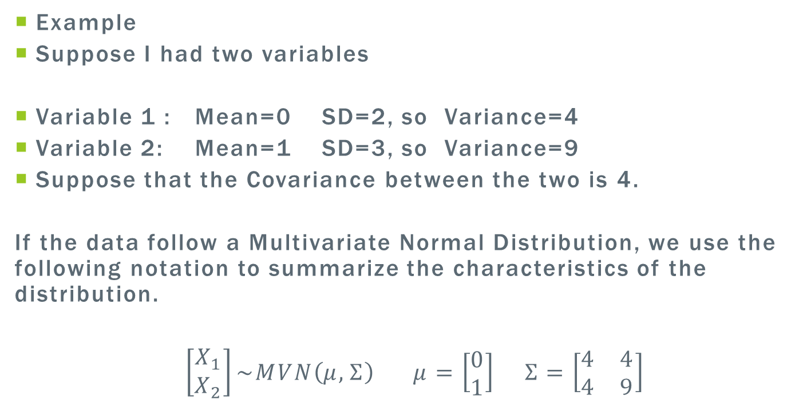
Variance-Covariance Matrix
Example
Suppose I had two variables
Variable 1 : Mean=0 SD=2, so Variance=4
Variable 2: Mean=1 SD=3, so Variance=9
Suppose that the Covariance between the two is 4.
If the data follow a Multivariate Normal Distribution, we use the following notation to summarize the characteristics of the distribution.
$\left[\begin{matrix}X_{1} \\ X_{2}\end{matrix}\right]\sim MVN\left(μ,Σ\right)$ $μ=\left[\begin{matrix}0 \\ 1\end{matrix}\right]$ $Σ=\left[\begin{matrix}4 & 4 \\ 4 & 9\end{matrix}\right]$

Slide 13
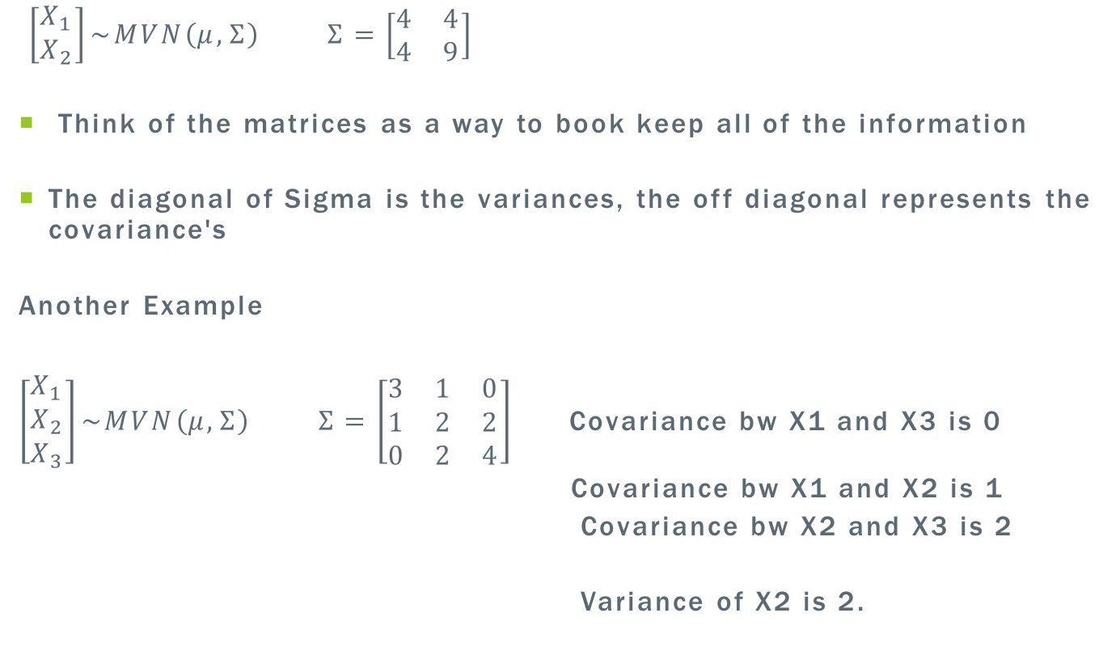
$\left[\begin{matrix}X_{1} \\ X_{2}\end{matrix}\right]\sim MVN\left(μ,Σ\right)$ $Σ=\left[\begin{matrix}4 & 4 \\ 4 & 9\end{matrix}\right]$
Think of the matrices as a way to book keep all of the information
The diagonal of Sigma is the variances, the off diagonal represents the covariance's
Another Example
$\left[\begin{matrix}X_{1} \\ X_{2} \\ X_{3}\end{matrix}\right]\sim MVN\left(μ,Σ\right)$ $Σ=\left[\begin{matrix}3 & 1 & 0 \\ 1 & 2 & 2 \\ 0 & 2 & 4\end{matrix}\right]$ Covariance bw X1 and X3 is 0
Covariance bw X1 and X2 is 1
Covariance bw X2 and X3 is 2
Variance of X2 is 2.

Slide 14
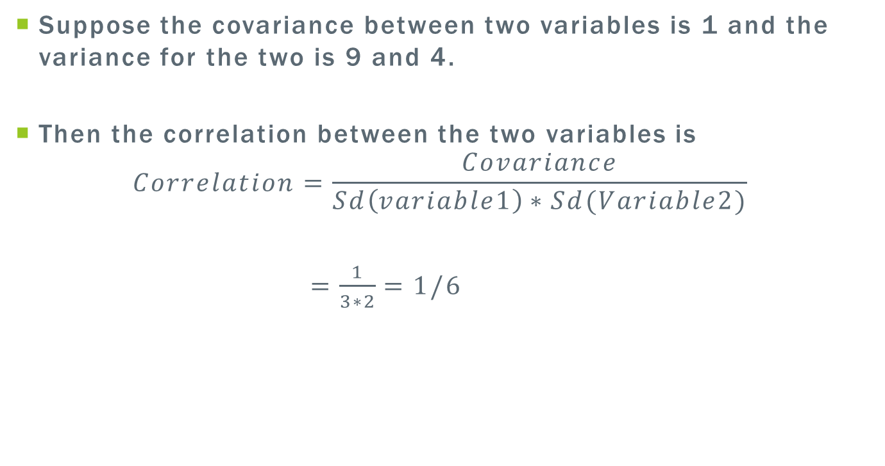
Relationship between correlation and covariances
Suppose the covariance between two variables is 1 and the variance for the two is 9 and 4.
Then the correlation between the two variables is
$$Correlation=\frac{Covariance}{Sd\left(variable1\right)∗Sd(Variable2)}$$
$=\frac{1}{3∗2}=1/6$

Slide 15
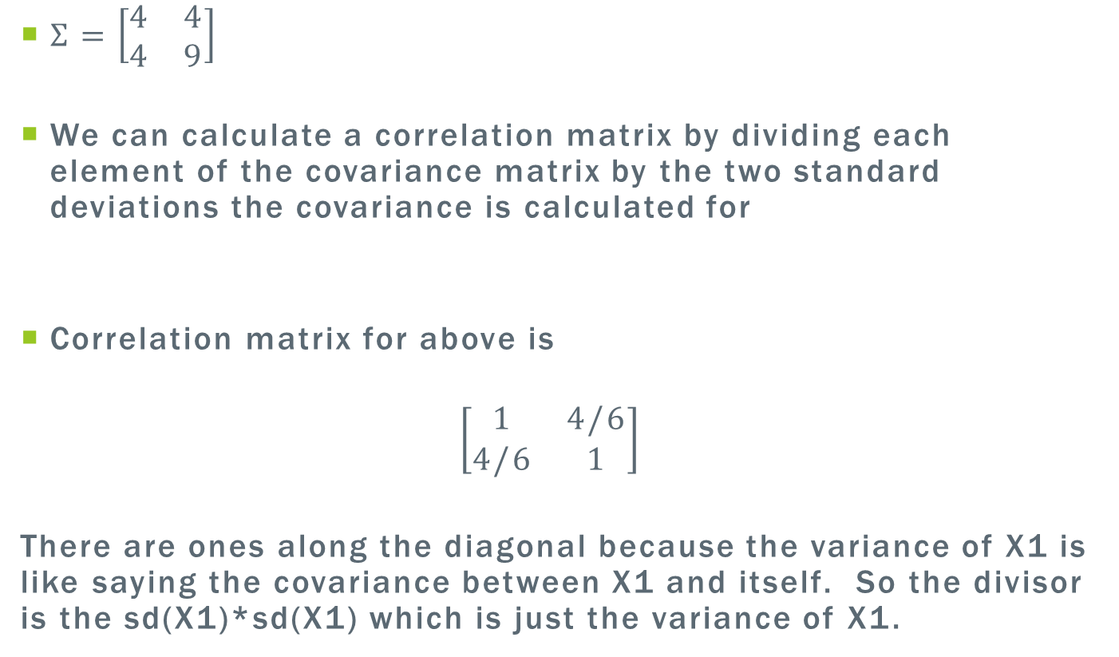
Covariance matrix to Correlation matrix
$Σ=\left[\begin{matrix}4 & 4 \\ 4 & 9\end{matrix}\right]$
We can calculate a correlation matrix by dividing each element of the covariance matrix by the two standard deviations the covariance is calculated for
Correlation matrix for above is
$$\left[\begin{matrix}1 & 4/6 \\ 4/6 & 1\end{matrix}\right]$$
There are ones along the diagonal because the variance of X1 is like saying the covariance between X1 and itself. So the divisor is the sd(X1)*sd(X1) which is just the variance of X1.

Slide 16
Properties of adding and subtracting variables that are correlated
Property of Adding (Averaging)
X+Y
Variance of X+Y is equal to Var(X)+Var(Y)+2*Cov(X,Y)
If X and Y are uncorrelated (independent) the COV(X,Y)=0
Var(X+Y) = Var(x) + Var(y)
If X and Y are positively correlated, the Var(X+Y) will be larger than what it would be if they are independent

Slide 17
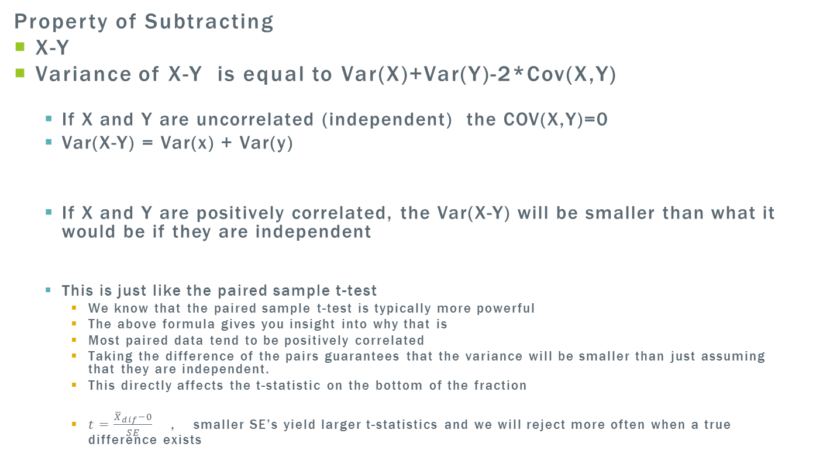
Properties of adding and subtracting variables that are correlated
Property of Subtracting
X-Y
Variance of X-Y is equal to Var(X)+Var(Y)-2*Cov(X,Y)
If X and Y are uncorrelated (independent) the COV(X,Y)=0
Var(X-Y) = Var(x) + Var(y)
If X and Y are positively correlated, the Var(X-Y) will be smaller than what it would be if they are independent
This is just like the paired sample t-test
We know that the paired sample t-test is typically more powerful
The above formula gives you insight into why that is
Most paired data tend to be positively correlated
Taking the difference of the pairs guarantees that the variance will be smaller than just assuming that they are independent.
This directly affects the t-statistic on the bottom of the fraction
$t=\frac{{\overline{X}}_{dif}−0}{SE}$ , smaller SE’s yield larger t-statistics and we will reject more often when a true difference exists

Slide 18
Big Picture (When we know data are correlated)
Using the multivariate strategy, we can keep track of all the correlations that exist in the data by treating the repeated measures as their own variable.
When we start conducting ANOVA Ftest’s as well as contrasts, we ensure that the appropriate standard errors are calculated.
Averaging across correlated(+ positively) data will have larger standard error estimates
Subtracting two components that are correlated(+ positively) will have smaller standard error estimates

Slide 19
Assignment Discussion

Slide 20
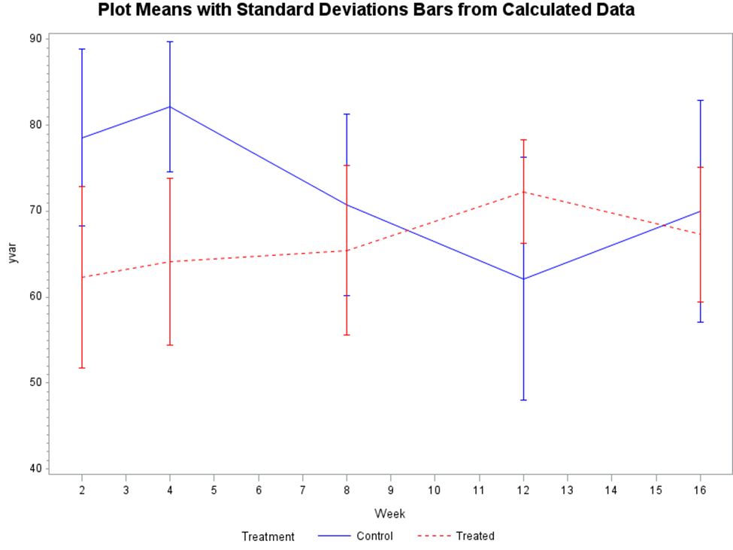
Monkey Data
Display 16.1 shows a good display of the data. The main question being, is there a difference between the treatment versus untreated groups for the earlier time points (2 4) and is there a difference between treatment versus untreated groups for the later time points (8 12 16).

Slide 21
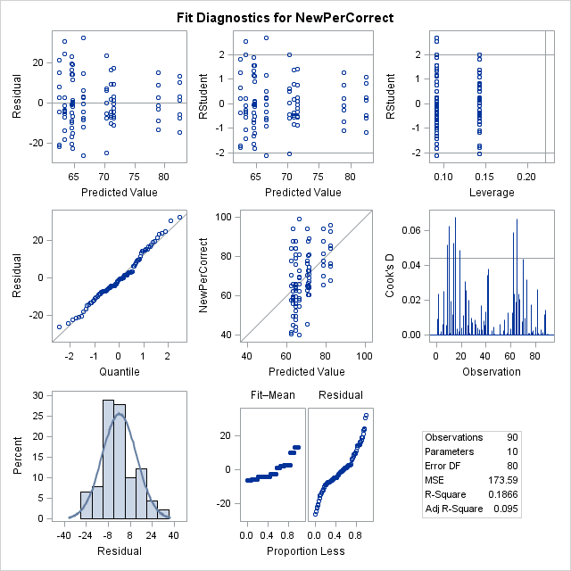
Two Way ANOVA Residual Analysis

Slide 22
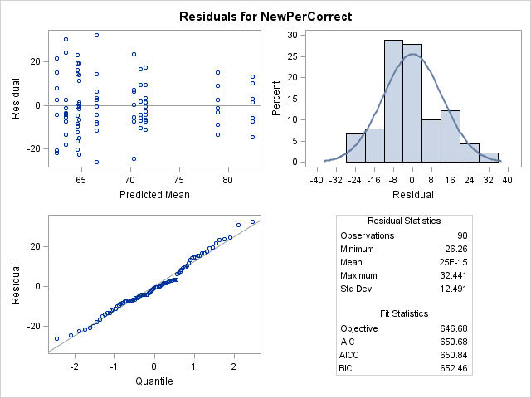
Repeated Measures Residual Analysis

Slide 23
GLM (Uncorrelated)
Source | DF | Type III SS | Mean Square | F Value | Pr > F
Treatment | 1 | 1004.887789 | 1004.887789 | 5.79 | 0.0184
Week | 4 | 456.139893 | 114.034973 | 0.66 | 0.6237
Treatment*Week | 4 | 2005.774978 | 501.443745 | 2.89 | 0.0274
Mixed (Correlated)
Type 3 Tests of Fixed Effects
Effect | Num DF | Den DF | F Value | Pr > F
Treatment | 1 | 16 | 2.36 | 0.1443
Week | 4 | 64 | 1.03 | 0.3971
Treatment*Week | 4 | 64 | 4.54 | 0.0027

Slide 24
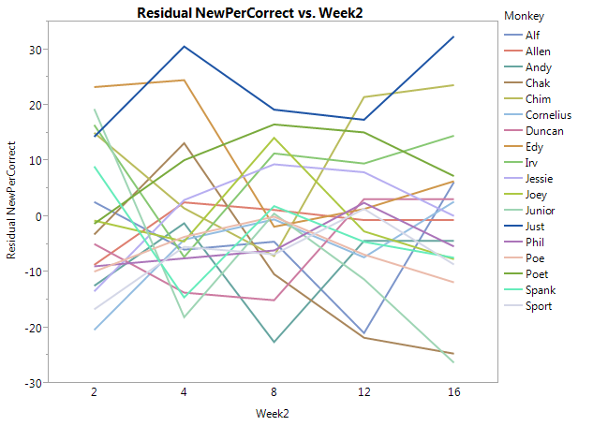
One way to tell how strong a correlation exists in repeated measures
Create Profile Plots for each subject using the residuals from 2 way anova

Slide 25
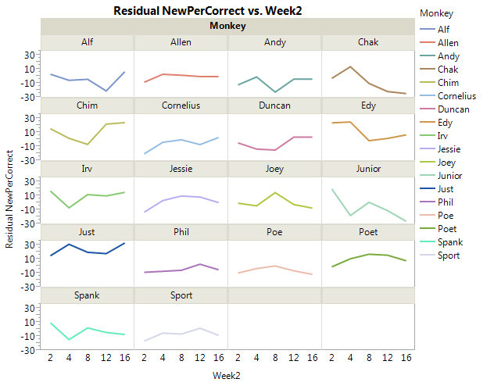
One way to tell how strong a correlation exists in repeated measures
If each subject’s residuals tend to fluctuate around a value other than 0
The idea is subject variability. Subjects with high residuals tend to stay high, low with low, medium with medium

Slide 26
GLM (Uncorrelated)
Parameter | Estimate | Standard Error | t Value | Pr > |t|
What is this contrast? | -16.6690385 | 4.50442969 | -3.70 | 0.0004
Trt vs Control W2 | -14.2606611 | 6.37022556 | -2.24 | 0.0280
Wk12 vs Wk2 Treated | 6.9364920 | 5.61801087 | 1.23 | 0.2206
Mixed (Correlated)
Estimates
Label | Estimate | Standard Error | DF | t Value | Pr > |t|
What is this contrast? | -16.6690 | 5.2611 | 64 | -3.17 | 0.0024
Trt vs Control W2 | -14.2607 | 6.3702 | 64 | -2.24 | 0.0287
Wk12 vs Wk2 Treated | 6.9365 | 4.4796 | 64 | 1.55 | 0.1264

Slide 28
General Analysis Plan
Dr. McGee illustrates the multivariate technique through GLM and is totally valid. Very helpful when you don’t want to have the sphericity assumption attached.
I am partial to using PROC MIXED
Handles missing data (GLM throws it away)
Natural extension and set of programming tools of GLM like contrasts and ANOVA tables. No transforming of the data.
Estimation technique gets standard errors correct in split plot designs, parameters that are strictly positive can sometimes be estimated as negative in GLM
Can fit sphericity, multivariate approach of GLM, as well as a wide number of other structures, use AIC or BIC to model select
Being careful with multivariate approaches
Sometimes the sample size/(number of repeats) will create problems estimating the large number of parameters in the full multivariate model

Slide 29
General Analysis Plan
Again, plotting data through profile plots when dealing with factors or subjects, summary stats, and identifying key variables to include in the model
Fit full model including an extra term that deals with the repeated measures (Repeated statement)
Residual diagnostics
Plot residuals for constant variance and normality
Proc GLM test for sphericity/ compound symmetry
Proc mixed fit different correlation structures use AIC/BIC model selection
Once an appropriate model is determined
Conduct the appropriate analysis tests given the particular modeling strategy, this could be MLR, 1way/2way anova, etc.
High level testing (ANOVA F tests for designs involving categorical factors, like two way anova) / test for regression coefficients for continuous
Test using contrasts for more specific questions of interest / or investigating significant categorical factors

Slide 30
Monkey Data from Start to finish
Main Question- Does blocking a particular region of the brain effect monkey’s long term and short term memory ability

Slide 31
Fit Full Model
Our case we are dealing with 2 categorical factors like a Two Way ANOVA
proc mixed data=monkey;
class Treatment Memory Monkey Week;
model PerCorrect=Treatment Week Treatment*Week;
repeated Week/ type=CS subject=Monkey;
*NOTE week is redundant you can leave blank;
*We have a choice on what type to use CS, UN, AR(1) etc
Run;quit;

Slide 32
Examine Residuals

Slide 33
Lets Compare models of Correlation Structure
repeated Week/ type=CS subject=Monkey; *Sphericity;
repeated Week/ type=UN subject=Monkey; *Unstructured Full Multivariate;
repeated Week/ type=AR(1) subject=Monkey; *Autoregressive;
There are half a dozen other ones we can try (see help);
Each time you run proc mixed, the top of the result file will give the models AIC BIC etc.
Note: You can only compare the models when the model statement is exactly the same (Model PerCorrect=Treatment Week Treatment*Week;)

Slide 34
AIC Values
CS/Sphericity
650.7
Unstructured Full Multivariate
667.2
Autoregressive
652.5 (but time points were not equally spaced)
Winner

Slide 35
Overall ANOVA TABLE
We still, in general, will approach it by testing to see if an interaction is significant.
This will still be informative for this study. No interaction indicates the change between treatment and control does not depend on time point so the change at earlier time points is equivalent to the change at the later time points.
Based on significant interaction and main effects. Conduct any contrasts that need to be calculated.
Remember, unplanned need to be multiple tested adjusted

Slide 36
Overall ANOVA
Null Model Likelihood Ratio Test
DF | Chi-Square | Pr > ChiSq
1 | 14.60 | 0.0001
Type 3 Tests of Fixed Effects
Effect | Num DF | Den DF | F Value | Pr > F
Treatment | 1 | 16 | 2.36 | 0.1443
Week | 4 | 64 | 1.03 | 0.3971
Treatment*Week | 4 | 64 | 4.54 | 0.0027

Slide 37
Specific Contrasts
Estimates
Label | Estimate | Standard Error | DF | t Value | Pr > |t|
What is this contrast? | -16.6690 | 5.2611 | 64 | -3.17 | 0.0024
Trt vs Control W2 | -14.2607 | 6.3702 | 64 | -2.24 | 0.0287
Wk12 vs Wk2 Treated | 6.9365 | 4.4796 | 64 | 1.55 | 0.1264

Slide 38
Exploring (Multiple Test Adjust)
Differences of Least Squares Means
Effect | Treatment | Week | _Treatment | _Week | Estimate | Standard Error | DF | t Value | Pr > |t| | Adjustment | Adj P
Treatment*Week | Control | 2 | Control | 4 | -3.5714 | 5.6155 | 64 | -0.64 | 0.5271 | Tukey-Kramer | 0.9997
Treatment*Week | Control | 2 | Control | 8 | 7.8571 | 5.6155 | 64 | 1.40 | 0.1666 | Tukey-Kramer | 0.9231
Treatment*Week | Control | 2 | Control | 12 | 16.4286 | 5.6155 | 64 | 2.93 | 0.0048 | Tukey-Kramer | 0.1198
Treatment*Week | Control | 2 | Control | 16 | 8.5714 | 5.6155 | 64 | 1.53 | 0.1318 | Tukey-Kramer | 0.8764
Treatment*Week | Control | 2 | Treated | 2 | 14.2607 | 6.3702 | 64 | 2.24 | 0.0287 | Tukey-Kramer | 0.4423
Treatment*Week | Control | 2 | Treated | 4 | 15.5060 | 6.3702 | 64 | 2.43 | 0.0177 | Tukey-Kramer | 0.3239
Treatment*Week | Control | 2 | Treated | 8 | 14.1424 | 6.3702 | 64 | 2.22 | 0.0300 | Tukey-Kramer | 0.4543
Treatment*Week | Control | 2 | Treated | 12 | 7.3242 | 6.3702 | 64 | 1.15 | 0.2545 | Tukey-Kramer | 0.9771
Treatment*Week | Control | 2 | Treated | 16 | 12.3242 | 6.3702 | 64 | 1.93 | 0.0575 | Tukey-Kramer | 0.6461
Treatment*Week | Control | 4 | Control | 8 | 11.4286 | 5.6155 | 64 | 2.04 | 0.0460 | Tukey-Kramer | 0.5783
Treatment*Week | Control | 4 | Control | 12 | 20.0000 | 5.6155 | 64 | 3.56 | 0.0007 | Tukey-Kramer | 0.0228
Treatment*Week | Control | 4 | Control | 16 | 12.1429 | 5.6155 | 64 | 2.16 | 0.0343 | Tukey-Kramer | 0.4924
Treatment*Week | Control | 4 | Treated | 2 | 17.8321 | 6.3702 | 64 | 2.80 | 0.0068 | Tukey-Kramer | 0.1588

Slide 39
Good Practice Run
In the monkey data set I sent out, I included another variable called “Memory”. This variable is just recoding the Week variable to indicate that WK 2 and WK4 are Short term, while the others are long term.
By parameterizing the model this way. You can run the model and Ask the Question Is Treatment different from Control for the Short term time points using a less complicated contrast.
Try it out and I bet you will get (exactly the same estimate, slightly different standard errors)
Repeated measures do not have to be in a two way anova type scenario like the monkey data, it can be general regression scenarios in terms of explanatory variables

Slide 40
Example of Simple Regression With Repeated Measures
Proc mixed data=dat;
Model y=month;
Random int month / type=UN subject=sub;
Run;
Random statement gives each subject their own regression line (intercept and slope)

Slide 41
Unit 8 Heads Up
MANOVA and Linear Discriminant Analysis
Nothing in the text for this so only videos for this week
Note : There is a lot of technical detail involving some linear algebra ideas. Try your best. It can be informative. The main focus for MANOVA is trying to realize how this relates to regular ANOVA and although the math is slightly more complicated, the process will be very similar to what we have done for regular ANOVA. Keep this in mind when watching. I will also discuss more high level what doing multivariate analysis really get you at the end of the day.
The general plan for MANOVA will be pretty short and concise. I will spend most of the session, making sure we get the big picture for LDA as well as start diving into R more.

Slide 42
Longitudinal Repeated measures
To me, this is a broad term
Repeated measurements on the same subject at different time points
Simplest Case
Treatment or factor level combination is assigned to each subject
The time point variable is not really of interest just indicates the repeated measurement

Slide 43


Longitudinal Repeated measures
Factor
Subject 1 Trt
Meas 1
Meas 2
Subject 2 Control
Meas 1
Subject 3 Control
Meas 1
Subject 4 Trt
Meas 3
Meas 2
Meas 3
Meas 2
Meas 3
Meas 1
Meas 2
Meas 3

Slide 44
The Idea of Subject as a BLOCK
In this simple case, you can view subject as a block.
We know there is variability between subjects
More than likely, the variability within a subject is small
This makes logical sense, they are on the same subject
A basic approach from the previous graph would be to model
Proc glm
Class Factor Subject;
Model Factor Subject;
Lsmeans factor / pdiff tdiff;
This unfortunately still gets it incorrect because the model still assumes independent errors which we know is not true. The F-test in the anova table is also not correct (this is a topic not covered in the course)

Slide 45
Crossover Design
Each treatment (factor level) is measured on the same individual
Order in which the factor levels are given to the subject is randomly assigned.

Slide 46
Cross over designs
Subject 1
Treatment
Control
Subject 2
Control
Subject 3
Control
Subject 4
Treatment
Treatment
Treatment
Control
Group
Trt then Control
Control then Trt
Why is this helpful to do it this way?
Each subject gets both treatment and control (like paired t-tests)
Controls for confounders
Typically more powerful
Concerns and difficulties–
Carry over effect. Sometimes the treatment doesn’t wear off and the second measurement, although it is labeled as a control, may be more like the treatment. Its hard to test for this. Multiple ways to write out the model depending on how the factors are recorded.

Slide 47
Split plot designs
Combination of the two previous ones
Factor 1
Subject 1 Trt
A
B
Subject 2 Control
A
Subject 3 Control
A
Subject 4 Trt
C
B
C
B
C
A
B
C
Factor 2
(A,B,C)

Slide 48
Monkey Data can be viewed as a split plot
Factor 1
Monkey 1 Trt
W2
W4
Monkey 2 Control
W2
Monkey 3 Control
W2
Monkey 4 Trt
W8
W2
W12
W16
W4
W8
W12
W16
W4
W8
W12
W16
W4
W8
W12
W16
Factor 2
(Weeks)

